Slide 1
Advanced Open Shortest Path First (OSPF)
Learning Outcomes:
Areas
Link State Advertisement (LSA)
Discontiguous Networks
OSPF Path Selection
Summarization
Route Filtering

Slide 2
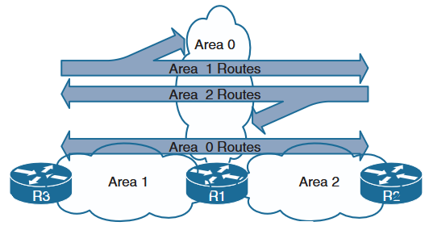
1. Areas
Logical partition of AS or grouping of router interfaces.
Floods and calculation of Dijsktra's algorithm is limited by area.
Every router in an area has exact same LSDB
To prevent overflooding, Dijsktra's algorithm run and limit size of LSDB, multiple area are needed.
Routes from one area to another are only injected via area 0 (backbone area).
Routers connecting area 0 to other areas (can be connected to multiple) are called Area Border Router (ABR).
Area ID can be in decimal format or dotted decimal format. Such as 0 or 0.0.0.0
ABR R1 has interfaces in Area 0,1 and 2

Slide 3
2. Link State Advertisement
Six Types of LSA used for IPv4
Type 1 Router Link: Each router in OSPF area
Type 2 Network Link: DR in multi-access (broadcast) segment
Type 3 Network Summary: ABR originated for inter area link advertisement.
Type 4 ASBR: Summary LSA for specific ASBR
Type 5 AS External: External redistributed route
Type 7 External NSSA: Advertises redistributed routes to NSSA.
External routes are learned from outside of OSPF domain and are injected through redistribution.
Type 1,2 and 3 are used to create SPT for intra-area and inter-area communication.

Slide 4
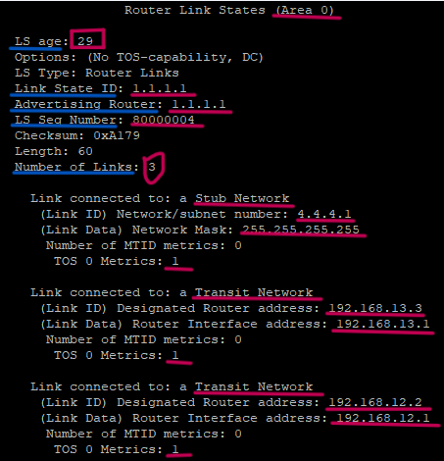
2. Link State Advertisement
Type 1: Router Link LSA
Exists for each OSPF enabled links
All links in same area of a router is advertised in a single Type 1 LSA identified by Link ID/RID.
Each link defined in Type 1 LSA has type of link (Stub, Transit, P2P), Link ID, Link Data and Metrics.
Field | Description
Age | LSA age since LSA was generated. Discarded after max age time. 3600 Sec
Link State ID | LSA ID, usually same as RID of advertising router
ADV Router | RID of the advertising router
Seq# | LSA seq# to identify old/stale and new LSA
Checksum | LSA Fletcher checksum
Link Count | Number of links connected to advertising router

Slide 5
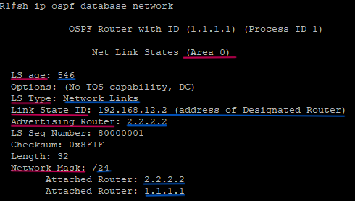
2. Link State Advertisement
Type 2: Network Link LSA
Every DR on a broadcast network segment in an area sends type 2 LSA.
Link State ID is the Designated Router interface IP in the segment.
Type 2 LSA contains network mask of the segment and the routers(RID) connected in the segment.

Slide 6
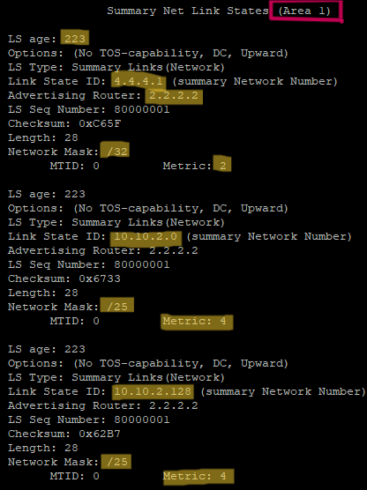
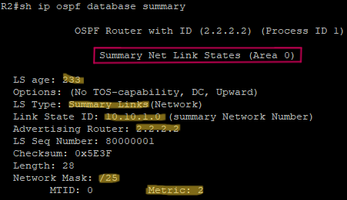
2. Link State Advertisement
Type 3: Summary LSA
Every ABR constructs Type 3 LSA from received Type 1 LSA for an area and forwards them to area 0 to make sure that the networks in non-backbone area is reachable.
If an ABR receives Type 3 LSA from area 0(reference), it constructs new Type 3 LSA for non-backbone area.
Thus, Type 3 LSAs are generated by ABR only.
Cost metric in Type 3 LSA is the total of cost metric in original LSA (Type 1 or Type 3) plus the metric to reach the Type 1 or Type 3 originating router.
The cost metric for inter area prefix will be calculated at a non-backbone router as cost to reach the ABR generating Type 3 LSA plus metric in received Type 3 LSA.
ABR uses best path metric while constructing Type 3 LSA to the prefix even if it has multiple path to reach the prefix.

Slide 7
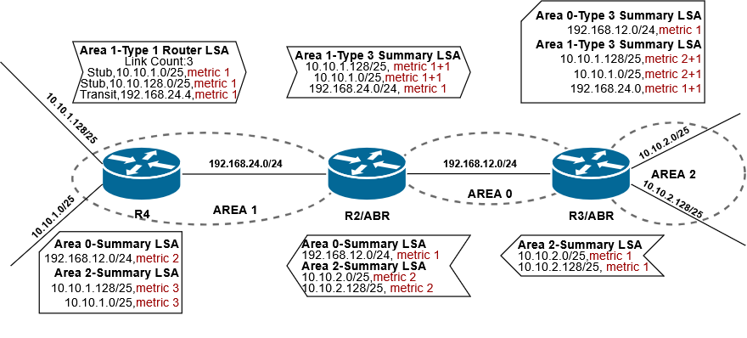
2. Link State Advertisement
Type 3: Summary LSA Construction and Flow
Each link is Ethernet link and has metric 1.
What other LSA flow in this network?
Between which routers?

Slide 8
3. Discontiguous Network
Every non-backbone area needs to have an ABR that has at least one interface in backbone area (area 0).
If not, the network is considered as discontiguous that affects inter-area communication.
The non-backbone area must be connected to backbone area physically or virtually.
Virtual links can be configured in non-backbone transit area to connect distant non-backbone area to backbone area.
R1(config)# router ospf 1
R1(config-router)# area 3 virtual-link 3.3.3.3
R3(config)# router ospf 1
R3(config-router)# area 3 virtual-link 1.1.1.1
Notes:
Red keywords , blue values

Slide 9
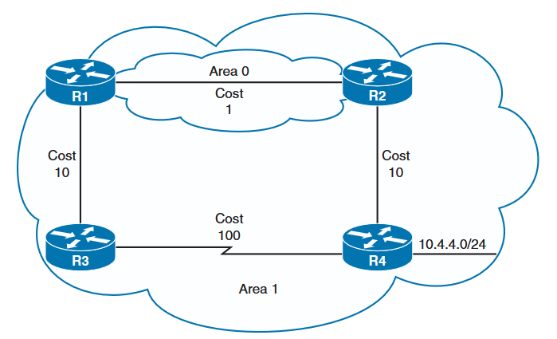
4. OSPF Path Selection
Multi-area path selection preference:
Intra-area (O)
Inter-area (O IA)
External Type 1 (O E1): Internal + external cost
External Type 2 (O E2): External cost only (redistribution)
If multiple intra-area paths to a prefix, then path with least path metric.
If there is tie in path metric, then all the paths with equal cost is installed into RIB.
By default, OSPF installs upto 4 equal cost paths (ECMP) into RIB.
Default value can be changed with maximum-paths maximum-paths command under ospf process.
For any inter-area path to be installed in RIB, it must traverse through backbone area (area 0).
For R1 to reach prefix 10.4.4.0/24:
Path-1:R1-R3-R4, metric 111, intra-area
Path-2:R1-R2-R4, metric 12, inter-area
R1 selects Path-1 as it is intra-area
Notes:
Red keywords , blue values

Slide 10
5. Summarization
Summarization occurs in ABR
Without summarization, Type 3 LSA at ABR needs to be modified as per the changes inside an area.
Summarization suppresses Type 3 LSA for all subordinate routes and creates single summary aggregate Type 3 LSA
Summarization helps to reduce the size of LSDB, number of SPF calculations and number of Link State Advertisements.
The metric for summary LSA is the lowest metric of the subordinate prefixes.
Change in subordinate prefix metrics needs to be reflected in summary LSA metric, thus explicitly setting summary metric LSA is preferred.
Summarization in OSPF creates a discard route to null0 interface on ABR to prevent routing loops.
Such route has AD of 110
Command:
area area-id range network subnet-mask [advertise | not-advertise] [cost metric]
Example: Summarize 10.10.1.0/25 and 10.10.1.128/25 at R2
R2(config)# router ospf 1
R2(config-router)# area 1 range 10.10.1.0 255.255.255.0 cost 2
Notes:
Red keywords , blue values, [Options]

Slide 11
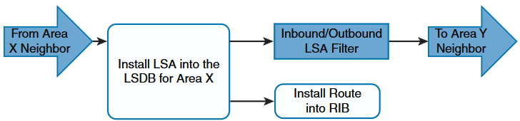
6. Route Filtering
Manipulate traffic flows, reduce memory utilization, or improve security.
Filtering with Summarization:
Example:
area 1 range 10.10.1.0 255.255.255.0 not-advertise
Limited in capability as it can be applied at ABR only.
Prevents routes being advertised to backbone area as well.
Area Filtering: Filtering Type 3 LSA
More flexible filtering
Filter prefixes at ABR from entering(in) and leaving (out) the area.
Filtered during generation of Type 3 LSA
Area Filtering order is shown below.
Area Filtering Command:
area area-id filter-list prefix prefix-list-name {in | out}
Example: Filter prefixes of area 1, 10.10.1.0/24 from entering area 2 but not in area 0.
R3(config)# ip prefix-list AREA1-IN seq 10 deny 10.10.1.0/24
R3(config)# ip prefix-list AREA1-IN seq 20 permit 0.0.0.0 le 32
R3(config)# router ospf 1
R3(config-router)# area 1 filter-list prefix AREA1-IN in
Notes:
Red keywords , blue values, [Options]

Slide 12
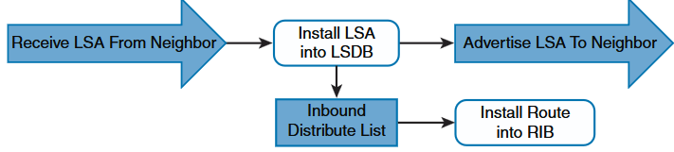
6. Route Filtering
Local OSPF Filtering- Filtering with distribute list:
Filter prefixes from installing into specific router RIB of an area.
Route exists in LSDB but not in routing table
Configuring distribute list on ABR prevents regeneration of Type 3 LSA coming from backbone area.
Because this regeneration happens after processing distribute list.
Thus, using distribute list to filter inter area prefixes is not recommended.
Below figure shows the order of Local OSPF filtering. With exception that Type 3 LSA regeneration from reference Type 3 LSA happens after distribute list.
Command:
distribute-list
{acl-number | acl-name | prefix prefix-list-name | route-map route-map-name} in
Example: Filter prefixes of area 2, 10.10.2.0/24 from installing into R4 RIB.
R4(config)# ip prefix-list BLOCK-102 seq 10 deny 10.10.2.0/24
R4(config)# ip prefix-list BLOCK-102 seq 20 permit 0.0.0.0 le 32
R4(config)# router ospf 1
R4(config-router)# distribute-list prefix BLOCK-102 in
Notes:
Red keywords , blue values, [Options]

